Slide 1
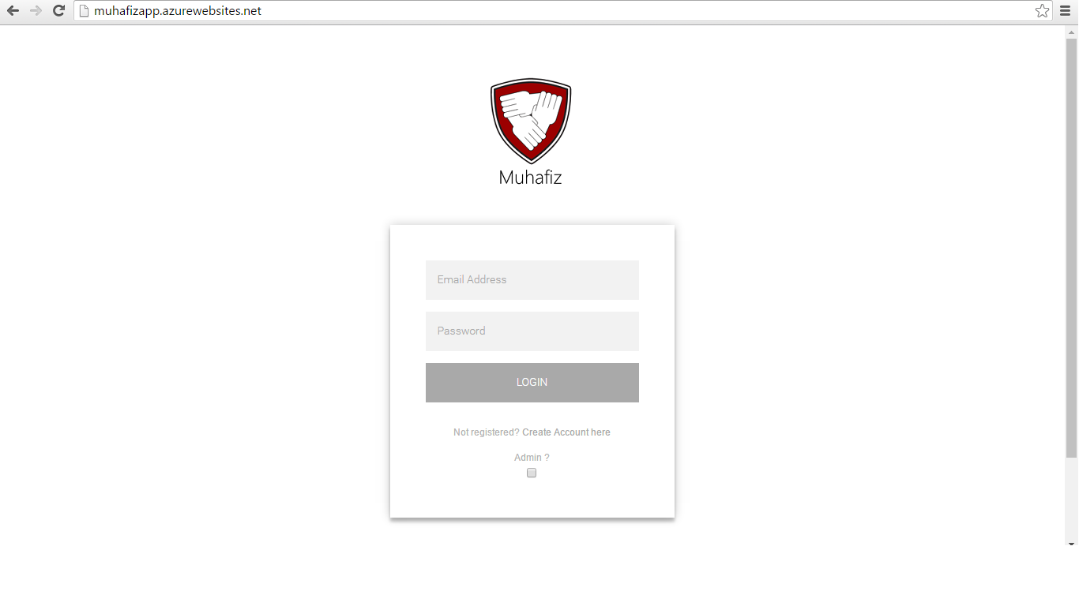
User Login
View : Login.cshtml
HomeController: Action Login [Get] displays Login form, and Action Login [Post]
run behind fomr submit. And Check credentials.
Model: cPerson is coupled with this view.

Slide 2
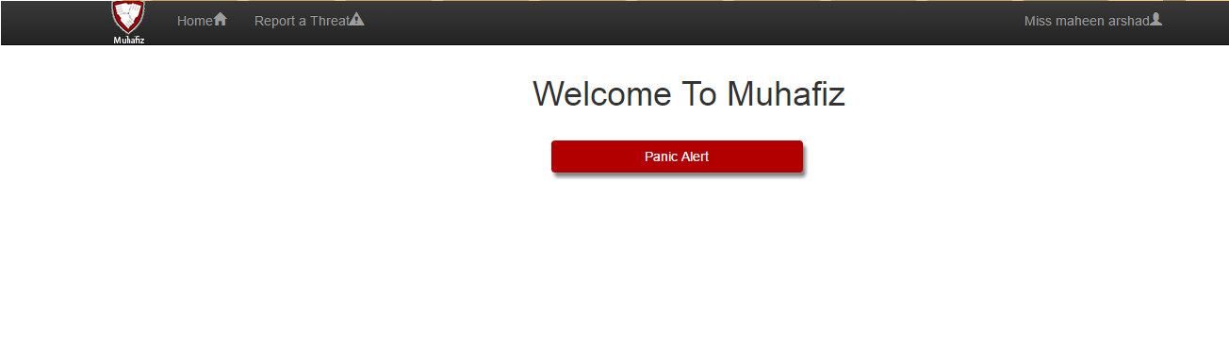
UserHome
View: LoginedHome.cshtml
UserController: Handles all the requests from User. Action LoginedHome displays this
view There is Panic Alert button , on Panic
Alert Action PanicAlertRequest [Post] is called.
Model : this view is coupled with cperson.cs

Slide 3
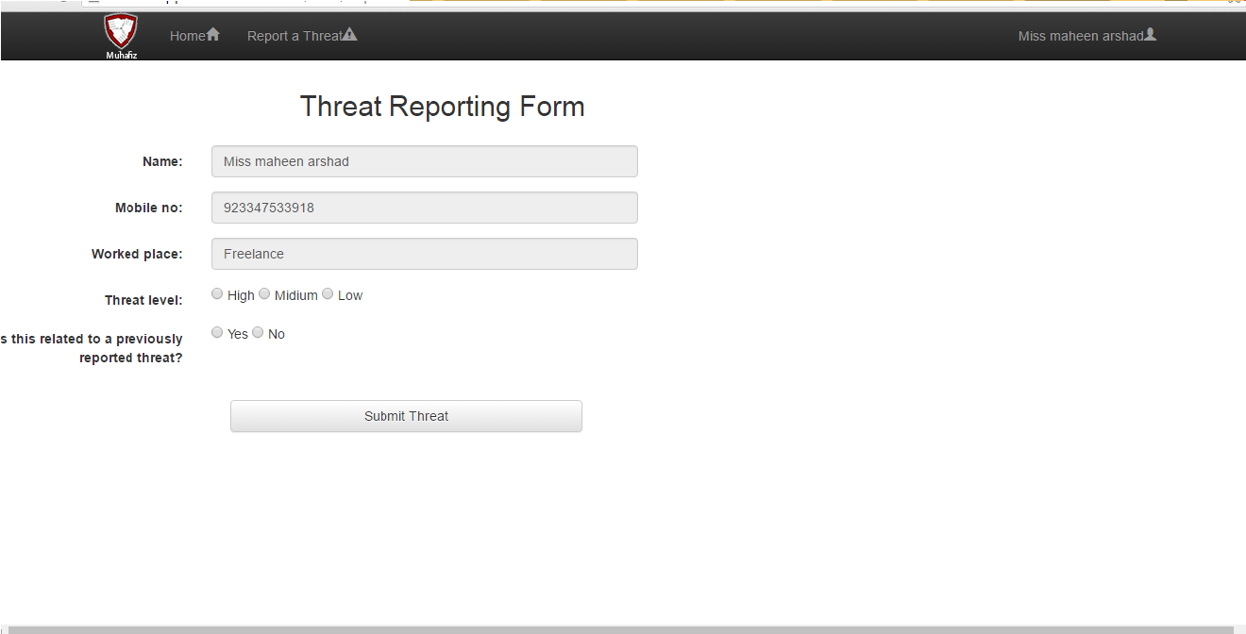
Report Threat
View: Reportathreat.cshtml
UserController: Action [Get]Reportathreat displays that form, then on form submit
[Post] Reportathreat action add threatreports in db.
Model: ThreatReportViewMode.cs is coupled with this view which includes Threat.cs,
ThreatNotification.cs, cperson.cs object.

Slide 4
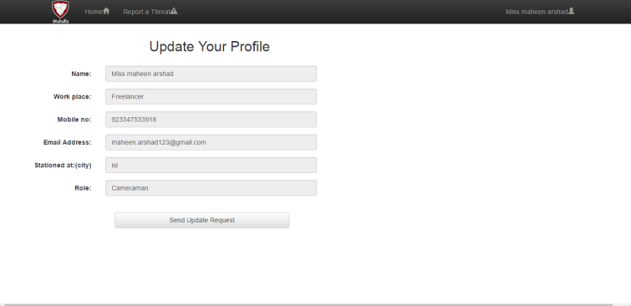
ProfileUpdateRequest
View: ProfileSettingRequest.cshtml
UserController: Action [Get] ProfileSettingRequest displays that form. And action
[post] ProfileSetting perform action of reuqesting in db.
Model: cperson.cs is coupled with this view.

